Slide 1
CPEN6234001 Computer Systems and Networks
GNS3 and Wireshark
Session 3
Ardimas Purwita
ardimas.andi@binus.ac.id
Notes:
‹#›

Slide 2
Objectives
GNS3
Wireshark

Slide 3
GNS3: Intro
source: https://docs.gns3.com
Graphical Network Simulator-3 (GNS3)
Open source software
The original intention from the creator is to help him to prepare for his Cisco’s certification exam (CCNP)
It’s been around for more than 10 years, and it can now be used to test real world deployments

Slide 4
GNS3: Supports
Emulation
run actual image
Cisco Internetwork Operating System (IOS), Linux, Windows
Simulation
simulate the behavior
L2 switch, physical medium

Slide 5
GNS3: Why should you care?
Real-time network simulation for pre-deployment testing without the need for network hardware:
Run the OS that emulates real behavior of network hardware
Test 20+ different network vendors in risk-free virtual environment:
Quickly run and test multiple hardware vendors without the need for hardware
Create dynamic network maps for troubleshooting and proof of concept (POC) testing:
Test your networks before you build them to reduce the time it takes to get a production network up and running

Slide 6
GNS3: Why should you care?
Connect GNS3 to any real network:
Leverage your existing hardware and expand your current lab by connecting your GNS3 topologies directly to it
Customized topologies and labs within GNS3 for network certification training:
GNS3 is the best study tool for aspiring network professional seeking their certifications, without the need for a home lab.

Slide 7
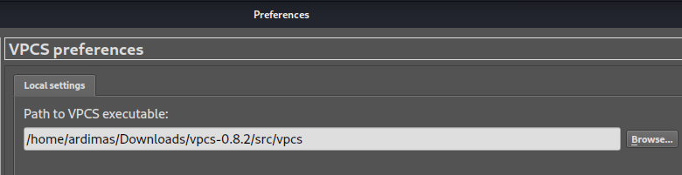
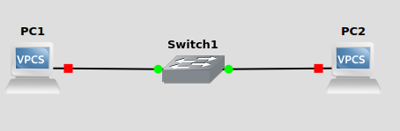
GNS3: 2VPCS and 1 Switch
VPCS: Virtual PC Simulator - Lightweight simulator for a PC to text connectivity only, e.g., ping
source: https://github.com/GNS3/vpcs
Steps:
Add 2 VPCs and 1 L2 switch from the sidebar
Don’t forget to add the VPCS binary that is already compiled before in the preferences window
In the console, set the IP address, e.g., ‘ip 10.1.1.1 255.255.255.0’

Slide 8
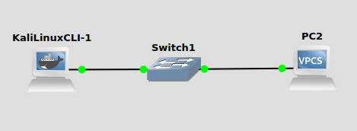
GNS3: With 1 Linux CLI
Replace a VPCs with a Kali Linux CLI
It is using Docker container
Now, you can use the Linux command, e.g.,
ip addr add 10.1.1.1/24 dev eth0

Slide 9
NAT
NAT: Network Address Translation
A mapping between address space to another address space
Typically a mapping between private IP address space (192,172,10) to a public IP address from our ISP

Slide 10
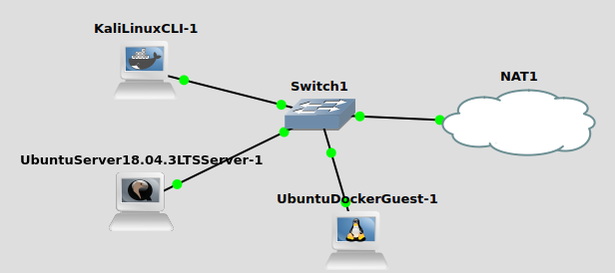
GNS3: A Simple Home Network

Slide 11
GNS3: NAT Configuration
NAT also runs DHCP server
Create a file ‘/tmp/default.xml’
<network>
<name>default</name>
<bridge name="virbr0"/>
<forward mode="nat"/>
<ip address="192.168.122.1" netmask="255.255.255.0">
<dhcp>
<range start="192.168.122.2" end="192.168.122.254"/>
</dhcp>
</ip>
</network>
$ # Type this in your terminal
$ virsh net-define /tmp/default.xml
$ sudo virsh net-start default
$ sudo virsh net-autostart default

Slide 12
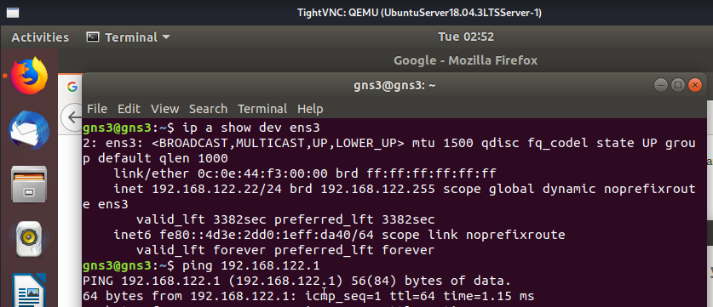
GNS3: Ubuntu Server Config
Nothing to be done as the interface is already setup (you can ping 192.168.122.1)

Slide 13
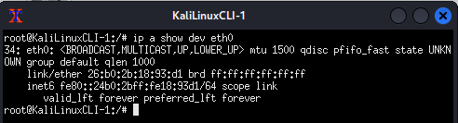

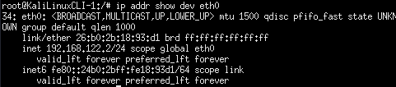

GNS3: Kali Linux CLI Config
It is not properly setup yet
Set your dns server
Now, you need to configure the IP address
$ ip addr add 192.168.122.2/24 dev eth0
Then, configure your route table
$ ip route add default via 192.168.122.1 via eth0

Slide 14
GNS3: Kali Linux CLI Config (optional)
To setup your apt, you need to first download and install:
https://http.kali.org/pool/main/k/kali-archive-keyring/kali-archive-keyring_2022.1_all.deb

Slide 15
Wireshark: Intro
Wireshark is a network protocol analyzer (https://www.wireshark.org/ )
It’s been around since 1998
Features:
Deep inspection of hundreds of protocols, with more being added all the time
Live capture and offline analysis
Multi-platform: Runs on Windows, Linux, macOS, Solaris, FreeBSD, NetBSD, and many others
Captured network data can be browsed via a GUI, or via the TTY-mode TShark utility
Support many capture file formats:
tcpdump (libpcap), Pcap NG, Catapult DCT2000, Cisco Secure IDS iplog, Microsoft Network Monitor,
Support description
etc

Slide 16
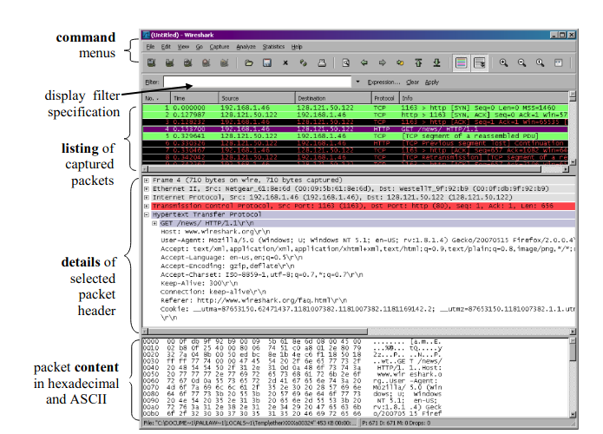
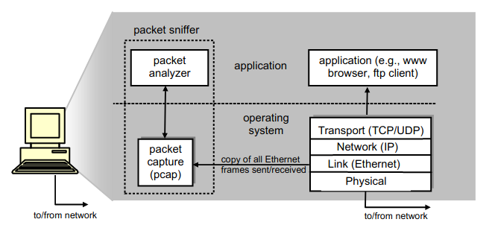
Wireshark: Intro

Slide 17
Wireshark Filtering
see: https://www.wireshark.org/docs/man-pages/wireshark-filter.html

Slide 18
tcpdump
Why do we need this?
GUI free
When you’re in a remote system that does not have a Wireshark installed yet
Cheat sheet:
https://cdn.comparitech.com/wp-content/uploads/2019/06/tcpdump-cheat-sheet-1.pdf

